Slide 1
Winnefox Library System
Trustee Orientation
2024

Slide 2
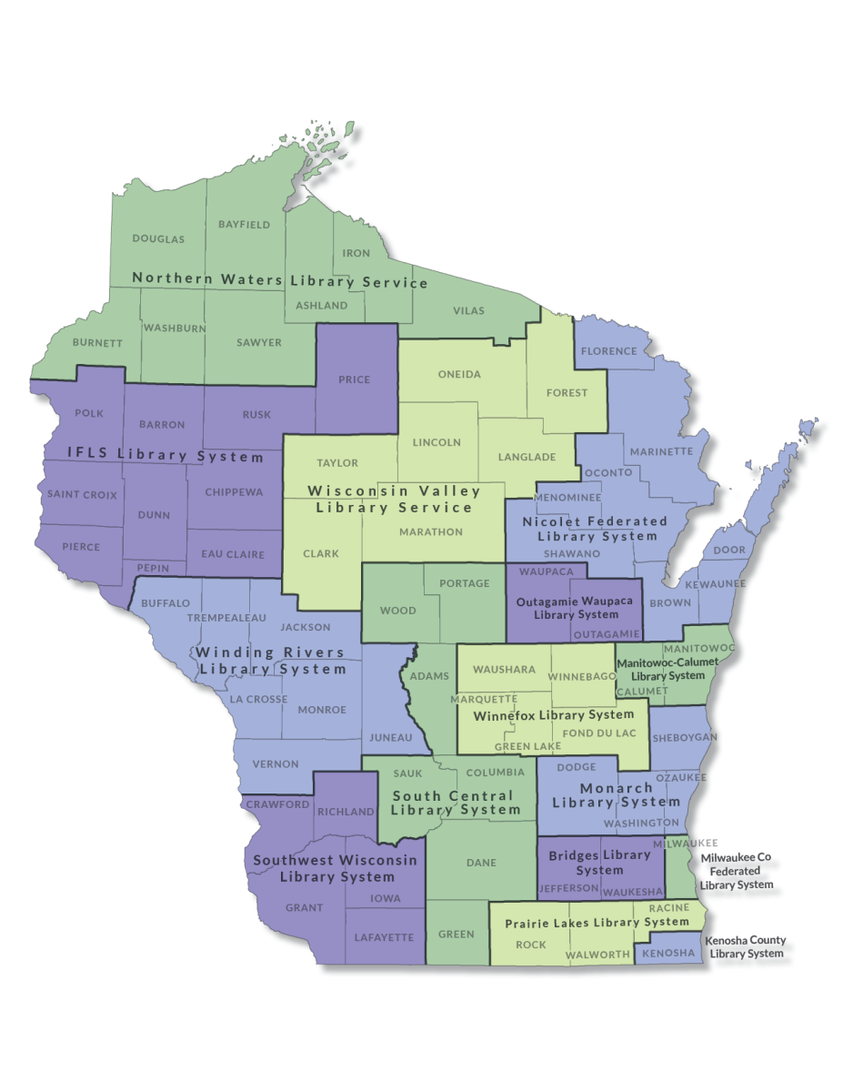
15 Public Library Systems

Slide 3
Winnefox History
1963
WGLC (Waushara-Green Lake Cooperative)
Cooperative services demonstration funded by a Federal Library Services Act (LSA) grant
County funded thereafter
1971
Wisconsin Public Library System Law passed
1976
Winnefox established (Green Lake, Waushara, Winnebago counties)
1978
Marquette County joined Winnefox
1990
WGLC became a Winnefox subprogram (as WCTS)
2000
Fond du Lac County joined Winnefox

Slide 4
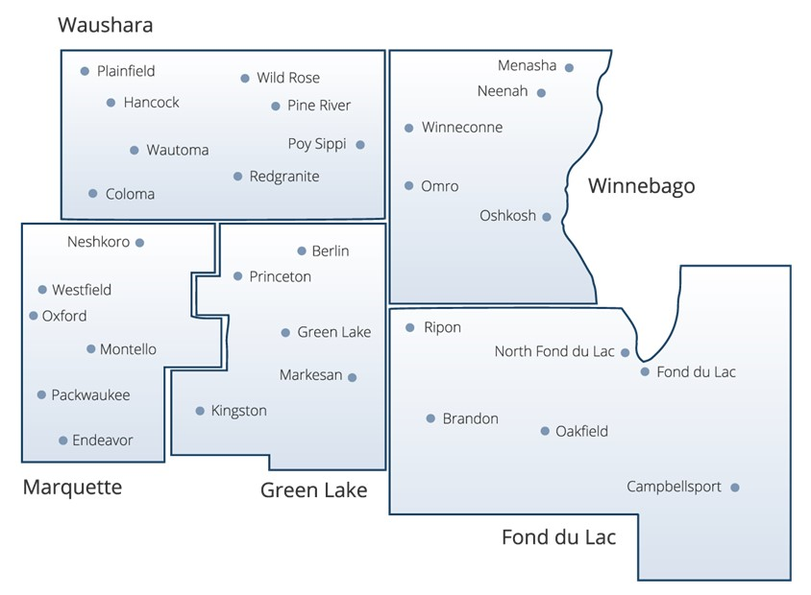
Winnefox Library System

Slide 5
Winnefox Mission
Promote the development of strong local libraries
Help libraries cooperate with each other and with other agencies
Provide “background” services to free up local staff time for public service
Advocate for library services

Slide 6
Winnefox Legal Context
Chap. 43, Wisc. Stats.
County Resolutions of Establishment
Member Library Agreement with each library.
County Agreements with Winnefox (5-year)
Agreements with other Systems
Resource Library Contract with Oshkosh Public Library (annual)
Contractual Services Agreement with Oshkosh Public Library (annual)

Slide 7
Winnefox Governance
23 member board of Trustees
Winnebago County: 10
Fond du Lac County: 7
Green Lake County: 2
Marquette County: 2
Waushara County: 2
State Statutes require that representation be proportionate to population.
One trustee from each county is a county board member

Slide 8
Winnefox Funding
State System Aid through the Department of Public Instruction (DPI)
(Increase in 2022 after 10 years of flat funding)
Member libraries for automation-WALS Fees
Green Lake, Marquette, & Waushara Counties- Winnefox Cooperative Technical Services (WCTS)
Contractual Services (examples: office staff, bookkeeping, and continuing education)

Slide 9
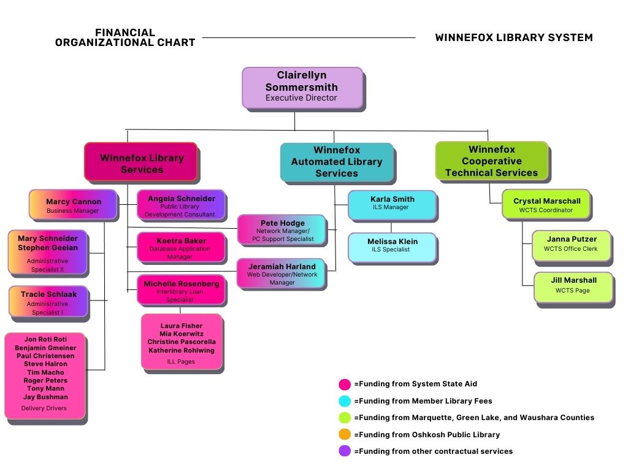

Slide 10
System State Aid– $1,298,937
WALS Member Fees – $726,691
Green Lake, Marquette and Waushara County (WCTS)– $204,041
Oshkosh Public Library – $159,095
Contractual Services – $53,477

Slide 11
State Required-Program Breakdown
Technology, Reference & Interlibrary Loan
ILS
Network
Technology Support
ILL/Reference
Electronic Resource
Continuing Education
CE
Consulting
System Programs
Delivery Services
Inclusive Services
Library Services to Youth
Public Information
Administration
Other System programs
County Planning
WCTS

Slide 12
Winnefox Service Programs Mandated Services –43.24(2)
Technology and resource sharing planning
Referral or routing of reference and interlibrary loan requests
Electronic delivery of information and physical delivery of library materials
Training for member library staff and trustees
Professional consultant services
Support for library service to users with special needs

Slide 13
Winnefox Service Programs Mandated Services –43.24(2)
Backup reference, information, and interlibrary loan services from the system resource library
Planning with other types of libraries in the system area
Service agreements with adjacent library systems
Agreements with each member library that require those libraries to serve all residents of the system area on the same basis as local residents
Providing continuing education workshops

Slide 14
Winnefox Service Programs Non-Mandated Services
PC support and repair
Web design & hosting
Summer program support
Electronic resource management
Digitization and database support
Printing and graphic support
Advantage Account with Overdrive

Slide 15
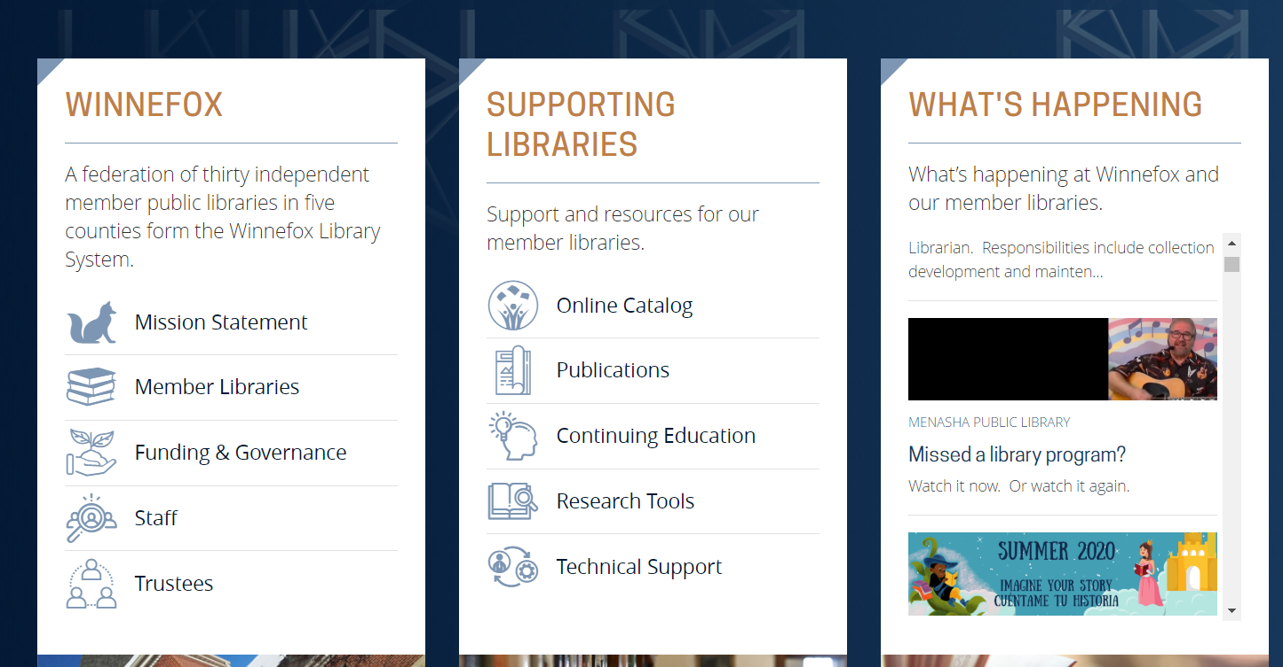
Winnefox Website

Slide 16
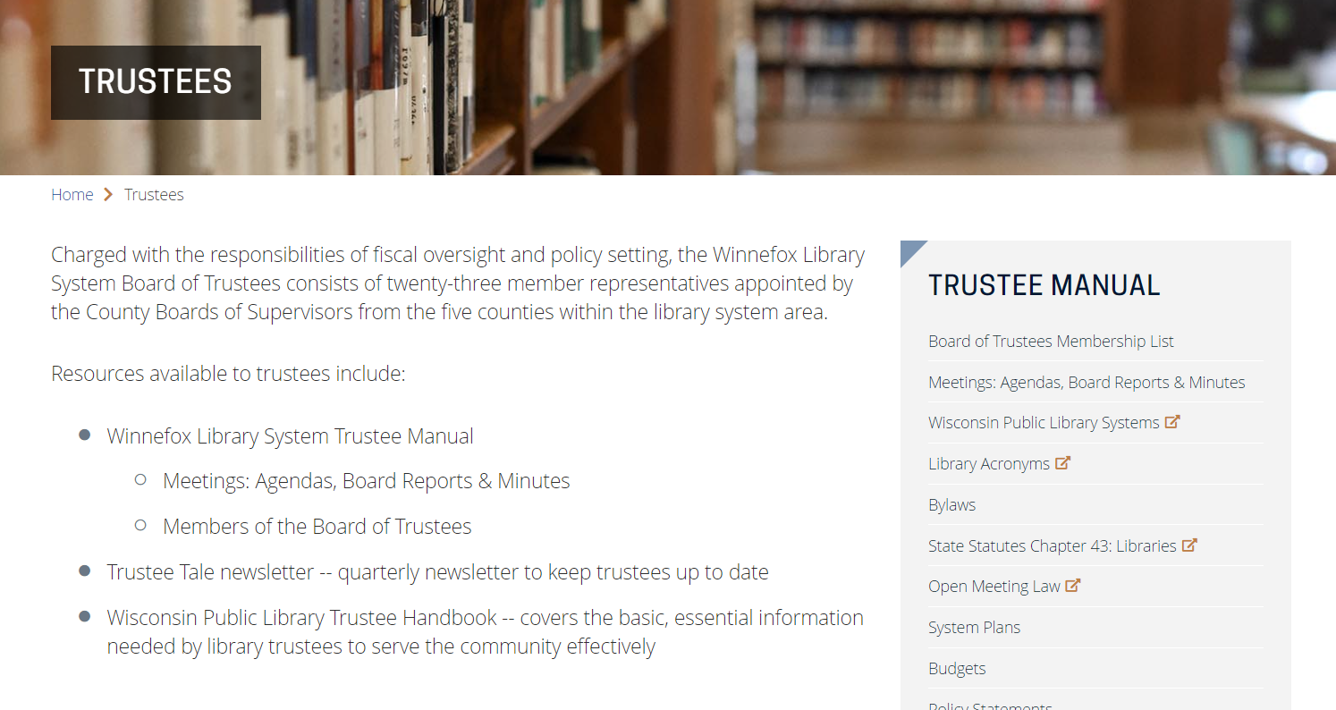
Winnefox Trustee Website

Slide 17
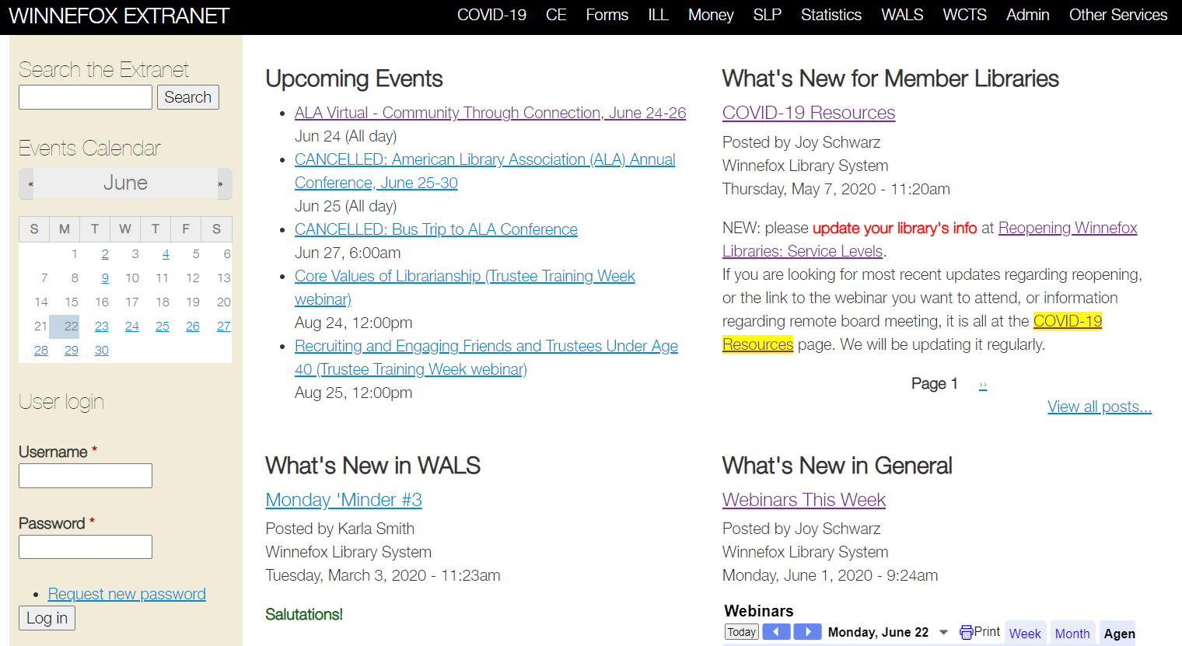
Member Libraries Extranet

Slide 18
Questions?
Board Meeting are held on the last Wednesday of the month at 4:30pm

