Slide 1
Winnefox Library System
Trustee Orientation
2018

Slide 2
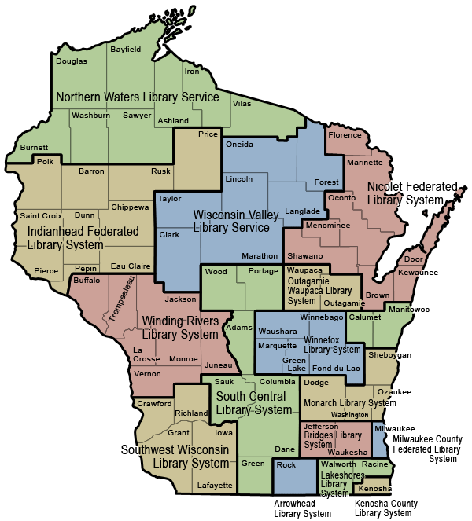
16 Public Library Systems

Slide 3
Winnefox History
1963— WGLC (Waushara-Green Lake Cooperative)
Cooperative services demonstration funded by a Federal Library Services Act (LSA) grant
County funded thereafter
1971— Wisconsin Public Library System Law passed
1976— Winnefox established (Green Lake, Waushara, Winnebago counties)
1978— Marquette County joined Winnefox
1990—WGLC became a Winnefox subprogram (as WCTS)
2000— Fond du Lac County joined Winnefox

Slide 4
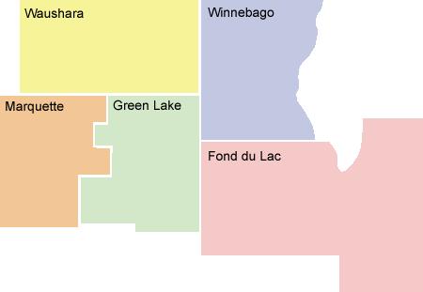
Winnefox Library System

Slide 5
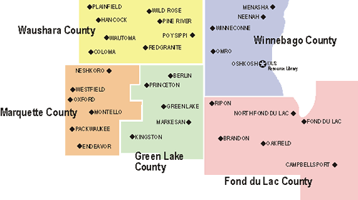
Winnefox Library System

Slide 6
Winnefox Mission
Promote the development of strong local libraries
Help libraries cooperate with each other and with other agencies
Provide “background” services to free up local staff time for public service
Advocate for library services

Slide 7
Winnefox Legal Context
Chap. 43, Wisc. Stats.
County Resolutions of Establishment
Member Library Agreement with each library.
County Agreements with Winnefox (5-year)
Resource Library Contract with Oshkosh Public Library (annual)
Contractual Services Agreement with Oshkosh Public Library (annual)

Slide 8
Winnefox Funding
State System Aid through the Department of Public Instruction (DPI)
2012 funding was a reduction of 10% from 2011
Increase in 2018 & 2019 for special projects
Member libraries for automation
Green Lake, Marquette, & Waushara Counties for Winnefox Cooperative Technical Services (WCTS)

Slide 9
Winnefox Governance
23 member board of Trustees
Winnebago County: 10
Fond du Lac County: 7
Green Lake County: 2
Marquette County: 2
Waushara County: 2
State Statutes require that representation be proportionate to population.
One trustee from each county is a county board member

Slide 10
Winnefox – Four Main Service/Funding Programs
Winnefox (WLS) Service Programs
Some state-mandated, some not
County Planning
Winnefox Technology Services and Winnefox Automated Library Services (WALS)
Winnefox Cooperative Technical Services (WCTS)

Slide 11
Winnefox Service Programs Mandated Services –43.24(2)
Technology and resource sharing planning
Referral or routing of reference and interlibrary loan requests
Electronic delivery of information and physical delivery of library materials
Training for member library staff and trustees
Professional consultant services
Support for library service to users with special needs

Slide 12
Winnefox Service Programs Mandated Services –43.24(2)
Backup reference, information, and interlibrary loan services from the system resource library
Planning with other types of libraries in the system area
Service agreements with adjacent library systems
Agreements with each member library that require those libraries to serve all residents of the system area on the same basis as local residents

Slide 13
Winnefox Service Programs Non-Mandated Services
PC support and repair
Web design & hosting
Summer program support
Local database design and hosting
Local history and genealogy, Summer program, Volunteers
Support for grant-writing through CESA 6
Printing

Slide 14
Winnefox Service Programs – $885,885 State Aids in 2018
Administrative Services (Mark Arend, Julie Schmude)
Interlibrary Loan (Michelle Rosenberg)
Delivery (Julie Schmude)
Printing
Continuing Education/Training (Joy Schwarz)
Consulting (Jeff Gilderson-Duwe, Mark Arend)

Slide 15
Special Project Funds
Workforce development, Lifelong learning, Broadband access
$29,504 in 2018 for Gale Courses
$59,007 in 2019

Slide 16
Winnefox Service Programs—Overdrive
eBooks, Digital Audiobooks, Video, & Music
Statewide collection
Winnefox collection
Use continues to increase every year
Have begun to factor use of digital materials into county plans and reimbursement requests

Slide 17
County Planning
County Librarian Advisory Committees (LAC)
County library funding
Billing for adjacent county billing (Act 420)
Past agreements have included funding for automation matching grants, building costs, & special collection development.

Slide 18
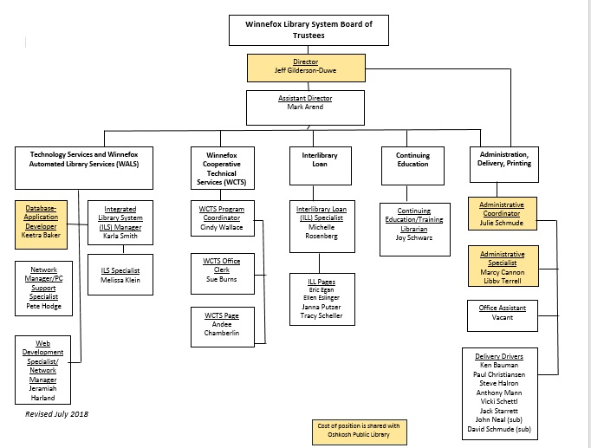

Slide 19
Winnefox Technology Services
Winnefox Technology Executive Council (WTEC)– Member Directors
PC Support Services
Online Database Support
Both purchased and locally-created databases
Website Hosting and Development
Training/Consultation
Four physical servers configured as about 20 virtual servers– NT; Win2000; Sun; Linux;

Slide 20
Winnefox Technology Services
Winnefox Automated Library Services (WALS)
2018 Budget = $854,229
Shared Winnefox & member library support
Shared catalog/circulation system/patron database
29 libraries (all except Fond du Lac PL)
Online Catalog
Network Management
Email support
Notes:
Catalog items unchanged for 2006

Slide 22
Winnefox Cooperative Technical Services (WCTS)
Located in the Berlin Public Library since 1963
Cindy Wallace (WCTS Program Coordinator)
Funded by Waushara, Green Lake and Marquette counties for the benefit of libraries in those counties
$180,659 in 2018
Cooperative selection & purchase of materials
Centralized cataloging & processing
Coordinate rotating collections
Audiobook & Large Print
Library Workdays

Slide 25
Winnefox Trustee Manual
Serves as a resource tool.
Paper copy?
Online version: http://www.winnefox.org/trustees/

Slide 27
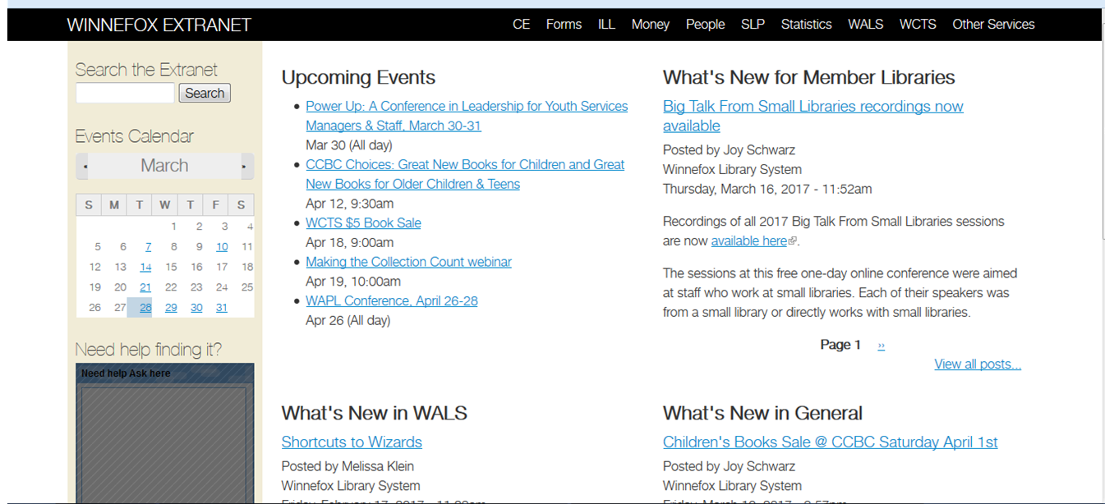
http://extranet.winnefox.org/

Slide 28
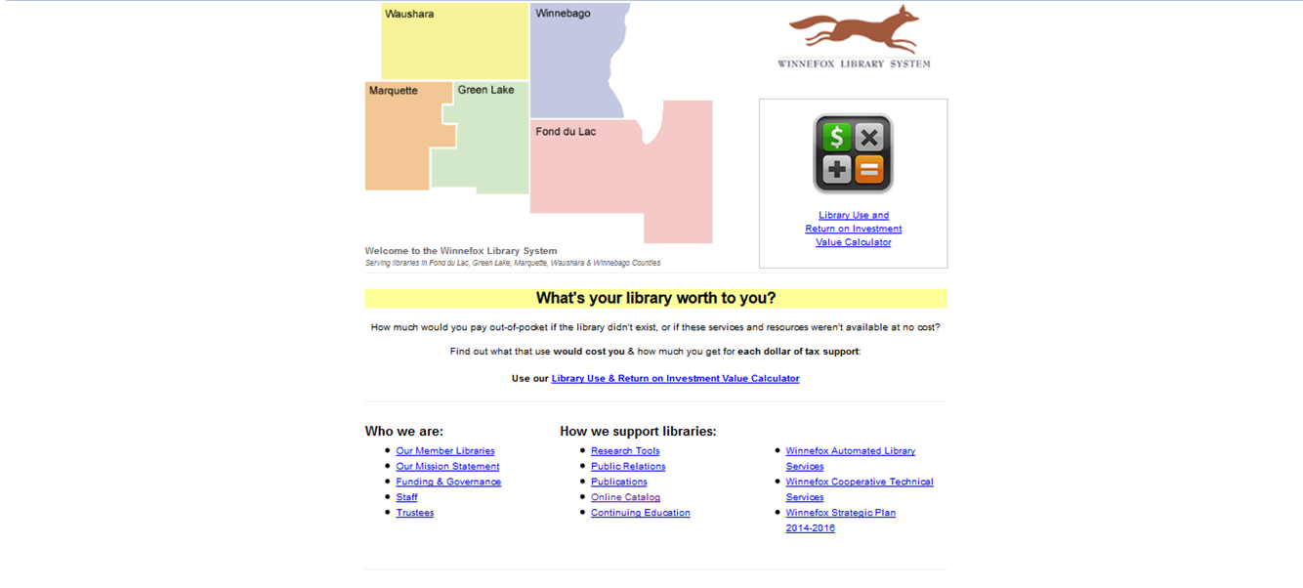
http://winnefox.org/

Slide 29
New Directions for System Services
Talks with Outagamie-Waupaca Library System
Continuing Education agreement with three other systems
Public Library System Redesign project (PLSR)
http://www.plsr.info/
http://dpi.wi.gov/pld/boards-directors/system-redesign

